Slide 1


Multi-Agent Career Architect
Orchestrating specialized AI agents for professional growth roadmaps and 3-month study plans using Google's Agent Development Kit (ADK).

Slide 2

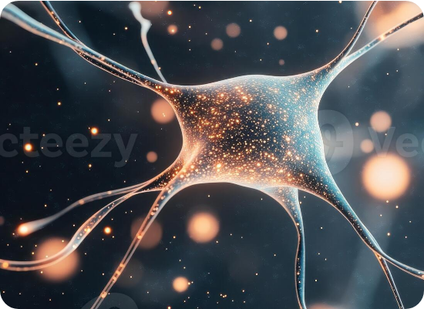
The Need for Precision
Standard LLMs often provide generic career advice. To build professional-grade roadmaps, a system requires:
→
Domain Expertise: Specialized knowledge in Cloud, AI, and Security.
→
Up-to-Date Data: Real-time access to certification costs and market trends.
→
Actionable Planning: Breaking high-level goals into week-by-week study tasks.

Slide 3

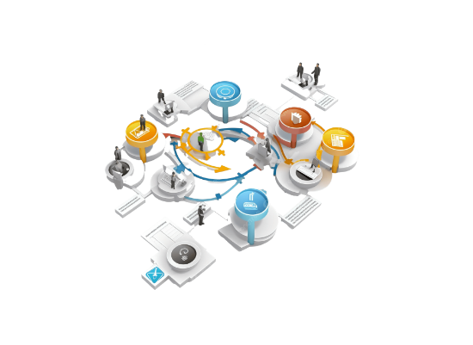
Orchestration Architecture
Router-Worker Pattern
The system utilizes a central Router Agent to classify intent and delegate tasks to Specialist Workers.
Built on the Google ADK, this modular approach ensures that the most relevant "brain" handles the specific technical domain.

Slide 4




The Brain: Router Agent
Intent Analysis
Dynamic Routing
Zero-Shot Selection
Processes natural language queries to identify the core career interest (e.g., "I want to learn Security").
Determines whether to activate the AI, Cloud, or Security specialist based on query context.
Returns only the worker name, maintaining high throughput and reducing token overhead.

Slide 5



Domain Expert Agents
AI Specialist
Cloud Specialist
Security Specialist
Roadmaps for ML, LLMs, and Data Science. Focuses on frameworks like PyTorch and Vertex AI.
Expertise in AWS, Azure, and GCP architectures with foundational to expert tiering.
Pentesting, Governance (GRC), and Network Defense certification paths.

Slide 6
Sequential Workflow Logic
Step 1
Step 2
Step 3
Step 4
Routing Analyze user query & select expert.
Roadmap Generate logical cert progression.
Extraction Identify target certification via Regex.
Action Plan Design 3-month detailed study plan.

Slide 7
The Technical Stack
Component | Technology Used | Role in System
Core Framework | Google ADK (Agent SDK) | Agent orchestration and tool management.
LLM Model | Gemini-2.5-Flash | Reasoning, roadmap design, and planning.
External Tools | Google Search | Fetching real-time market data and costs.
Deployment | Flask & Python | Serving the API and managing sessions.

Slide 8
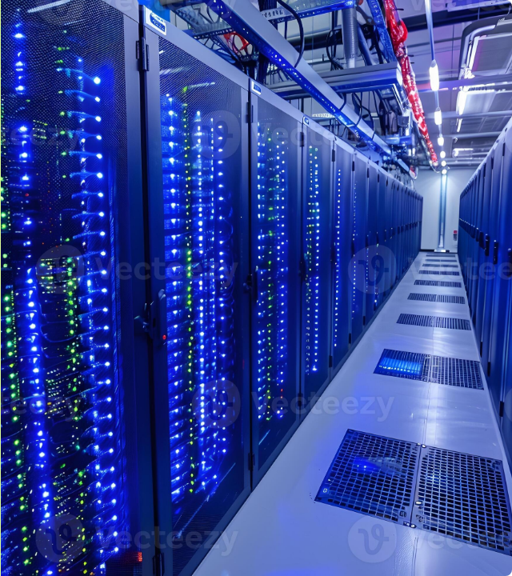
Real-Time Intelligence
Unlike static models, this system leverages the google_search tool to provide current insights:
→
Current Pricing: Latest exam fees for AWS/Azure/GCP.
→
ROI Analysis: Identifying high-demand certifications for the current year.
→
Study Resources: Finding the latest official documentation and training links.

Slide 9
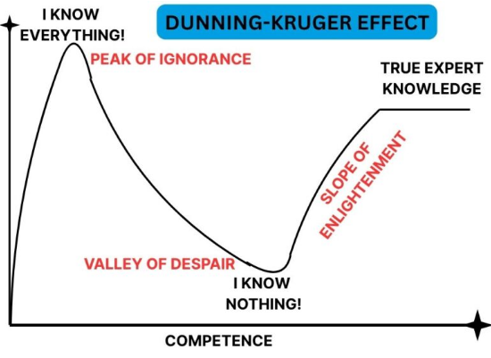
Month-by-Month Planning
Actionable Milestones
The system transforms a high-level roadmap into a 90-day execution plan:
→
Month 1: Foundations, core concepts, and environment setup.
→
Month 2: Intermediate features and hands-on lab projects.
→
Month 3: Practice exams, final review, and certification testing.

Slide 10
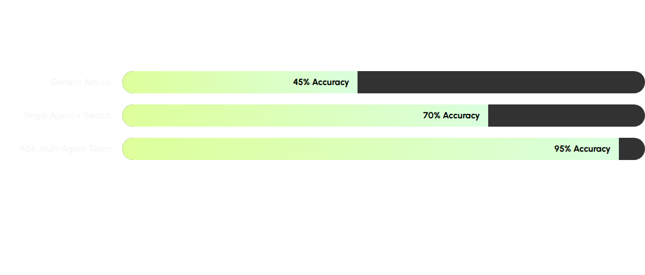
Strategic Performance
Multi-agent orchestration significantly reduces hallucinations and increases domain-specific precision.

Slide 11

Enterprise Scalability
The system is designed for production environments:
→
Session Management: InMemorySessionService ensures context is maintained across sequential calls.
→
REST API: Flask integration allows easy connection to frontend UIs.
→
Multimodal Future: Potential to integrate audio/video via ADK's streaming capabilities.

Slide 12
Questions & Answers
Exploring the future of autonomous career strategy through Google ADK and Multi-Agent Systems.
contact@ai-career-architect.io

Slide 13





Image Sources
https://static.vecteezy.com/system/resources/previews/065/613/679/large_2x/glowing-neural-network-structure-with-orange-particles-on-dark-background-abstract-network-connections-with-light-artificial-intelligence-neural-network-photo.jpeg
Source: www.vecteezy.com
https://png.pngtree.com/png-clipart/20250205/original/pngtree-3d-process-workflow-png-image_12997259.png
Source: pngtree.com
https://static.vecteezy.com/system/resources/previews/050/442/116/large_2x/modern-data-center-with-server-racks-and-blue-led-lights-for-cloud-computing-and-data-storage-photo.jpg
Source: www.vecteezy.com
https://www.editage.com/insights/wp-content/uploads/2025/05/dunning-kruger-effect-850x560.jpg
Source: www.editage.com
https://png.pngtree.com/png-clipart/20250228/original/pngtree-futuristic-cybersecurity-shield-with-lock-png-image_20534224.png
Source: pngtree.com

